Slide 1
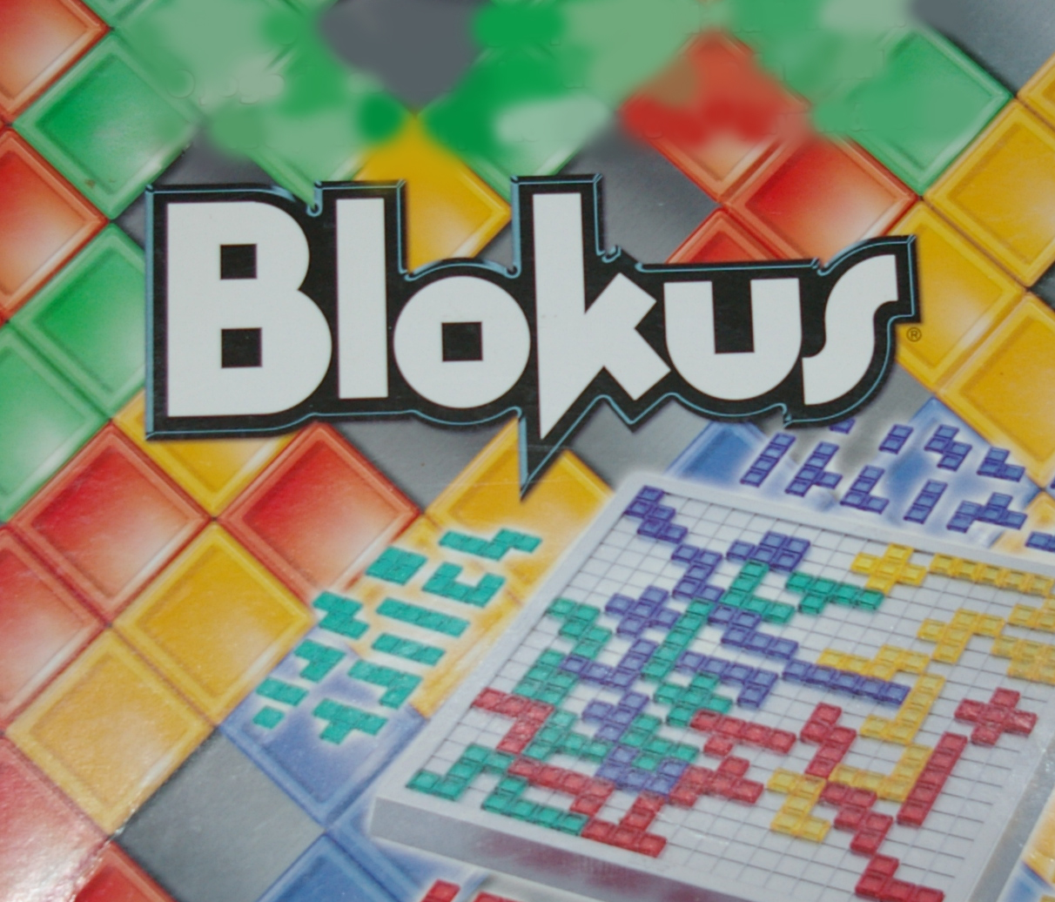

Brain developing strategy game

Slide 2
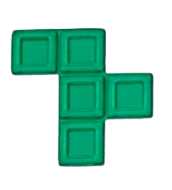
Game concept – summary
It can be played by 2-4 players. Each one of the players has personal stack of figures that he should left on the field by given conditions one by one.
The main goal of each player is to place all of his figures on the playfield.
Each figure is unique and it consists squares. Each square is 1 p point. The value of this figure on the picture is 5 points.
Each player has 21 different figures that are rotatable in all rr possible positions in order to place them better on the field .
The game is won by the player with highest score !

Slide 3
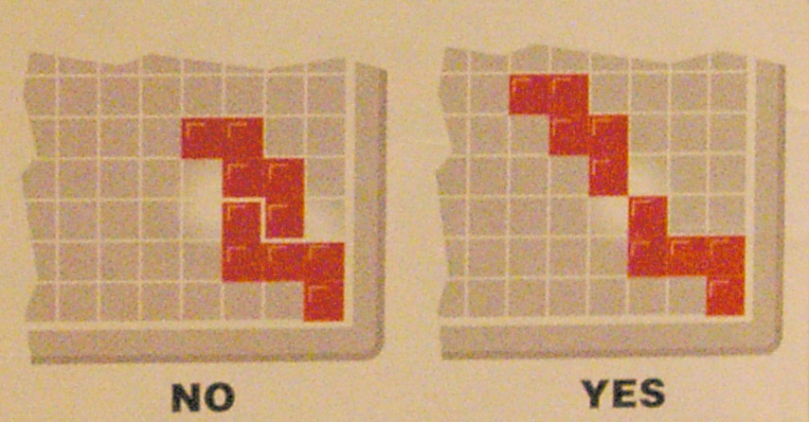
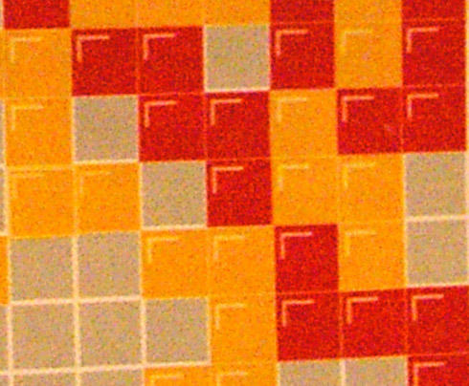
Rules for placing figure on the field
Each new piece must touch at least one other piece of the same color but only at the corners. Pieces of the same color cannot be in contact along an edge.
There are no restrictions on how pieces of different colors may contact each other.

Slide 4
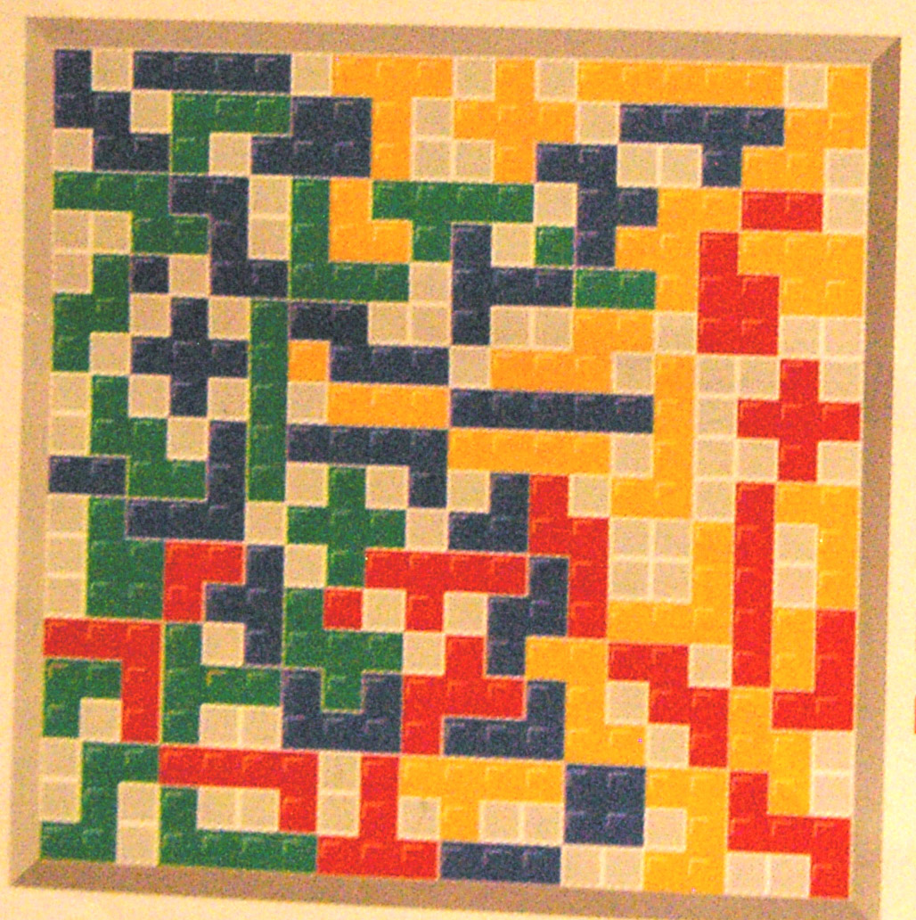
Example of late game
In this example we can simply see the game in completed stage. Each of the players has different remaining figures that he could not place during the game. In this case the player with less remained figure points is the winner. If the player place the special moving figure / 1 score figure / at last, he double his result.

Slide 5
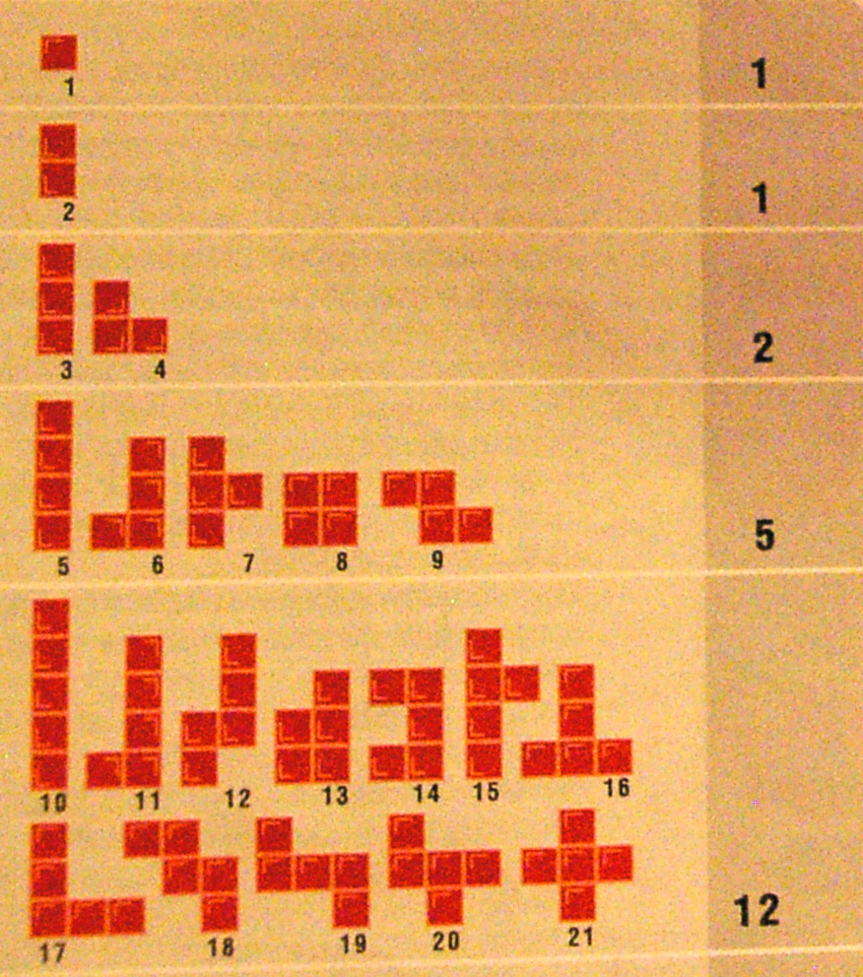
Player stack
Each player has his own personal stack of these figures.
Each one of them except a few has 8 possible rotations.

Slide 6
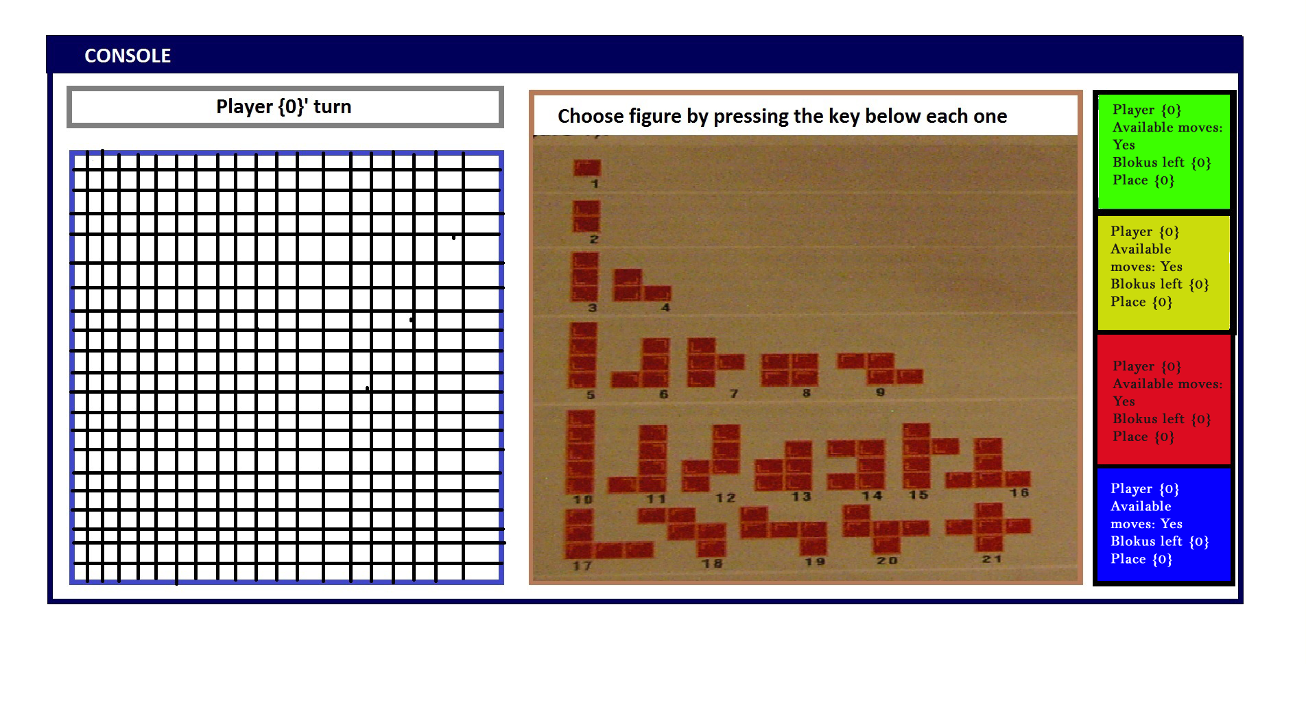
Game design during the planning

Slide 7
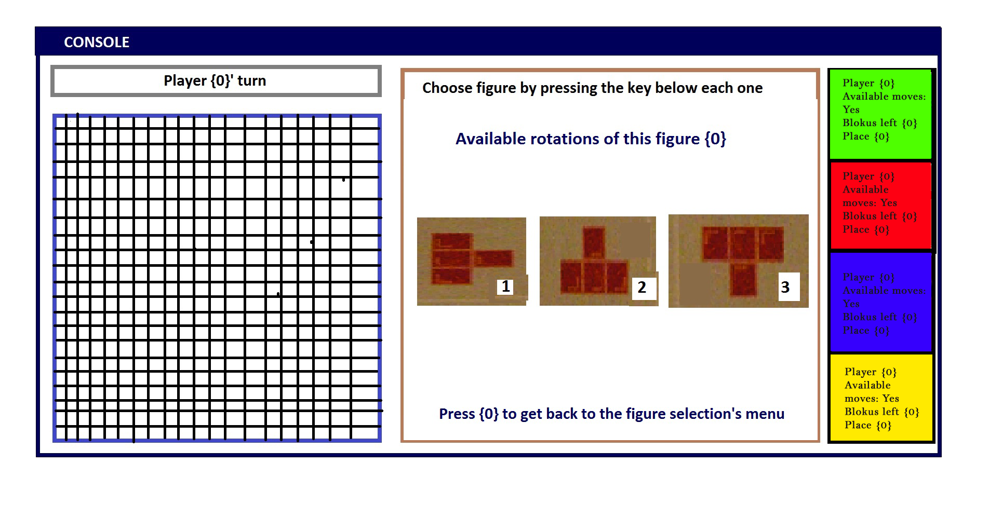
Game design during the planning

Slide 8
Game demo

